Slide 1
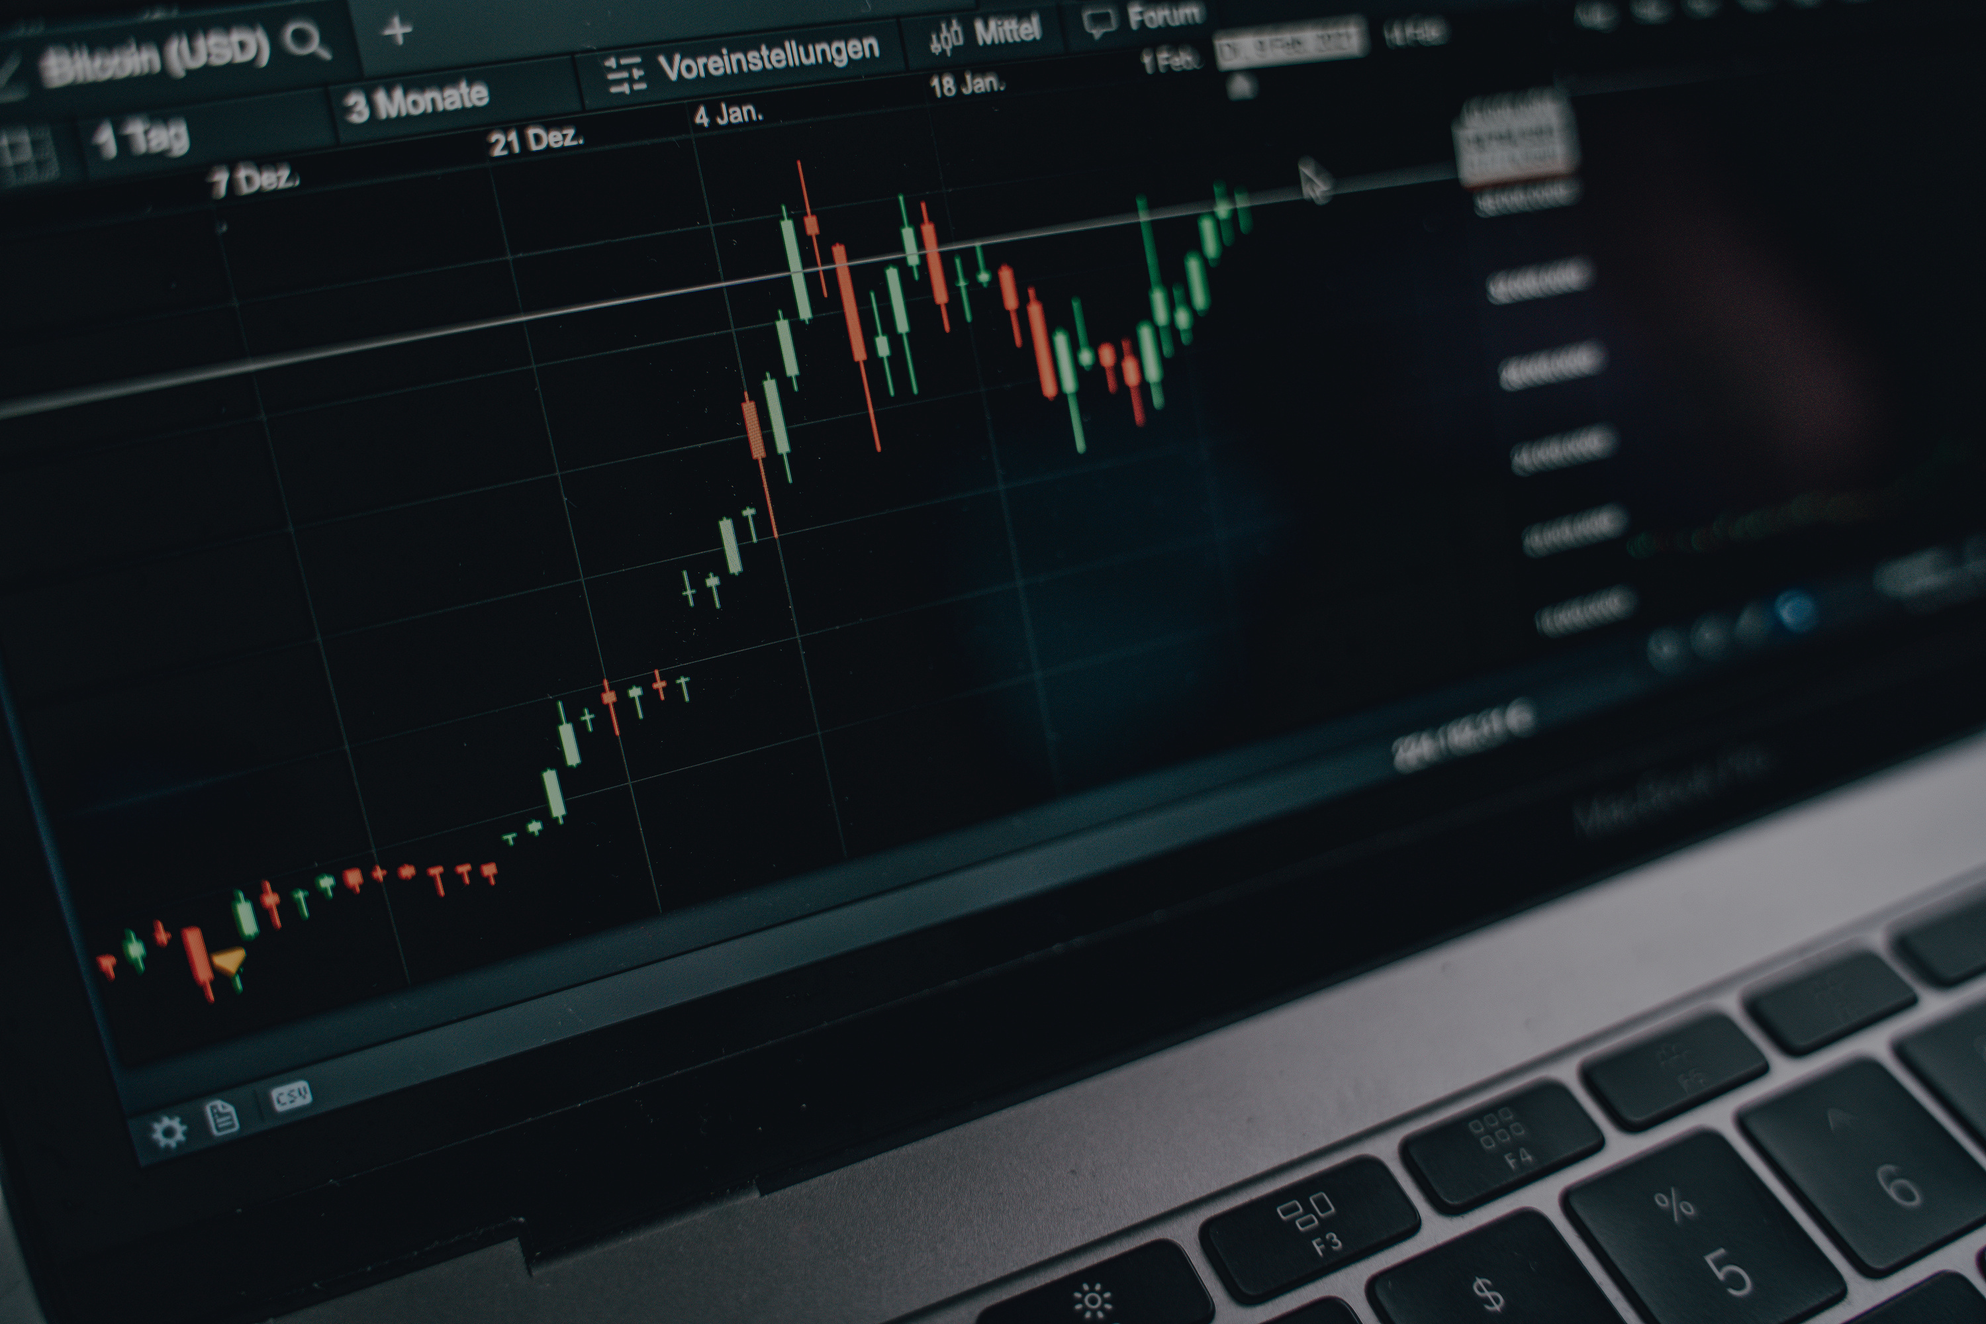
THE
STOCKBOWL
Who will win and who will remain a loser?
CINDY DUONG
KIRSTEN FORMENTO
DAVID JIAN
MARRY SHINTAKU

Slide 2

PERFORMING A FIXED-WINDOW, TECHNICAL ANALYSIS
We acknowledge that each company for each stock may be from different industries or run their operations uniquely. We cannot compare each company by how they are operated. This is specifically a technical analysis of the stock itself. We can only draw conclusions from the stock data.
WHAT IS THE TOP GAINERS & LOSERS LIST?
On January 30, 2025, we pulled a list of the stock market's top 20 gainers and the bottom 20 losers for that day. We selected 4 gainer stocks and 4 loser stocks from that list and performed a technical comparison.
The chosen stock list includes: NVDA, WOK, AVGX, YIBO, NRO, AKRO, DWTX, ELAB.
Please note that API data was pulled as of January 30, 2025. The time frame of analysis will be between the last quarter of 2024 and the first month of 2025. We understand that our analysis of the data will be restricted to this time frame (Fixed-Window Analysis) and that the stock performance is subject to change between the time the data was pulled to when this data was presented.
THE STOCKBOWL

Slide 3



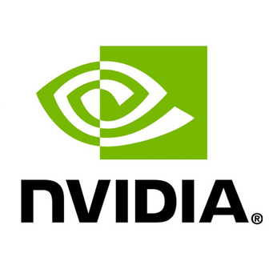







THE STOCKBOWL
HOME
ABOUT
MORE
Meet the Stocks
Gainers
Losers
TOP S&P 500 STOCK
ETF
NVDA
YIBO
WOK
AVGX
DWTX
AKRO
ELAB
NRO

Slide 4


BIG QUESTIONS
HOME
ABOUT
MORE
Which of these 8 stocks can make it to the playoffs, and win the Stockbowl?
Will the top performing stock on the S&P 500 win the game?
Can an ETF outperform the other stocks?
Could it potentially be the winner?
Will it stands its ground?
Who will be in the top 4? Who will be the real gainer?
NEXT >

Slide 5


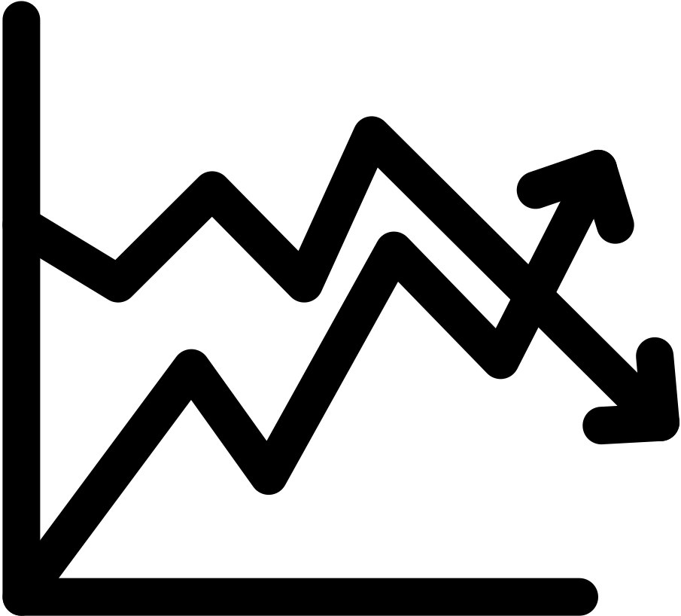
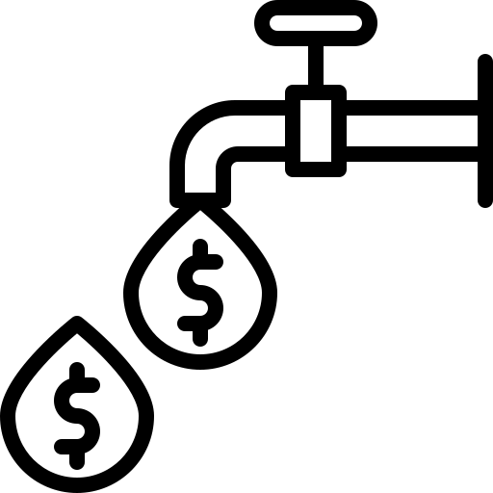
HOW WILL A STOCK WIN?
STABILITY
TREND CONSISTENCTY
VOLATILITY
LIQUIDITY

Slide 6

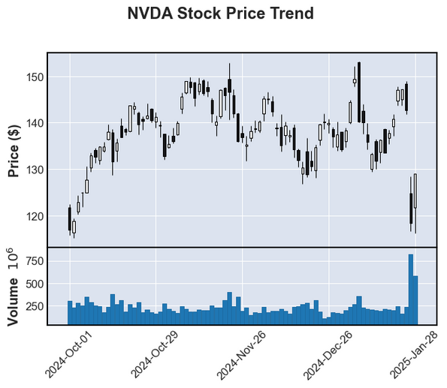
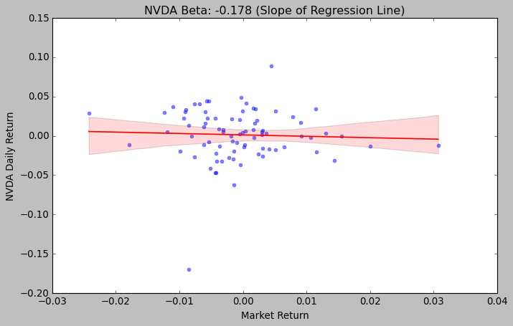
NVDA
Key Insights
✅ Stable Price Trend: Maintained steady movement before a significant price drop in late January.
✅ Controlled Volatility: Predictable price fluctuations, less erratic than speculative stocks; lower standard deviation.
✅ Consistent Liquidity: Steady trading volume enabled smooth execution with minimal slippage.
✅ Negative Beta (-0.178): Less market sensitivity, operating independently of broader trends.

Slide 7
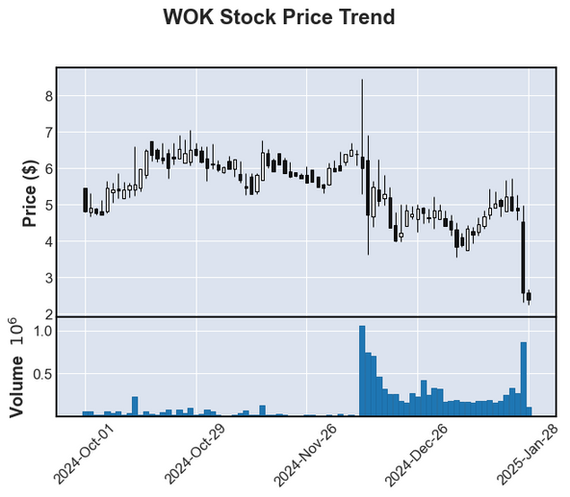
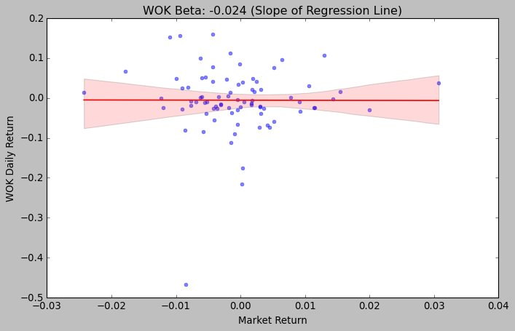
WOK
Key Insights
✅ Stable Price-Trend: Maintained steady movement before a significant price drop in late January.
✅ High Volatility: Experienced frequent price swings, indicating higher risk but also greater profit potential.
✅ Unstable Liquidity: Trading volume spiked during key price movements but remained inconsistent.
✅ Negative Beta (-0.024): Less market sensitivity, operating independently of broader trends.

Slide 8
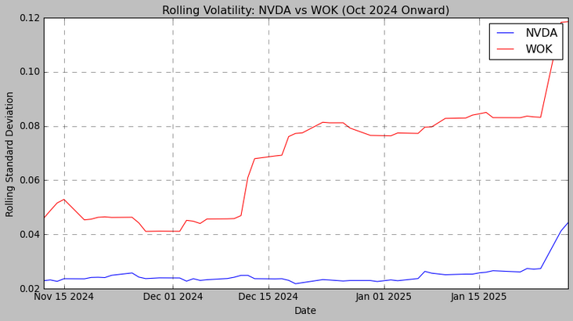
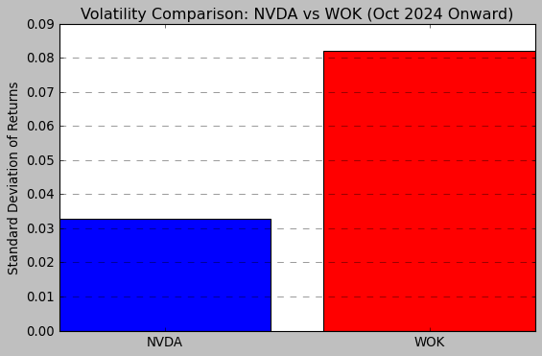
NVDA - WOK
Key Insights
✅ Greater Stability & Trend Consistency: NVDA maintained steadier price movements with fewer extreme swings, while WOK experienced sharp fluctuations.
✅ Superior Liquidity Control: NVDA showed consistent trading volume, ensuring smoother execution, whereas WOK had irregular liquidity spikes.
🏆 Overall Winner: NVDA
✅ Lower Volatility: NVDA exhibited more controlled price deviations, reducing risk compared to WOK’s erratic movements.
✅ More Reliable Market Behavior: NVDA’s stable trend and liquidity make it a safer and more predictable choice.

Slide 9

THE STOCKBOWL
ROUND 1
HIGHLIGHTS
NVDA stock wins against WOK!
Next up: DWTX vs ELAB

Slide 10
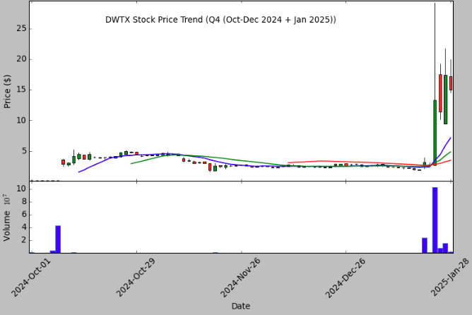
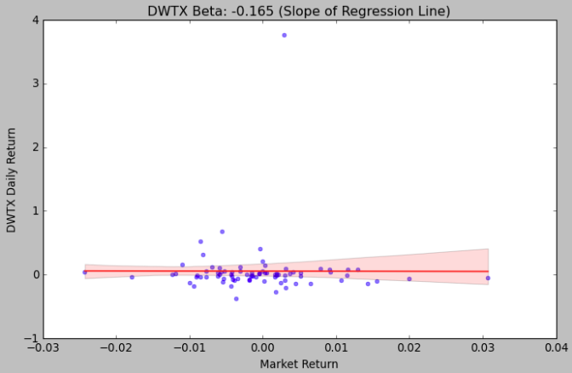
DWTX
Key Insights
✅ Stable Price Trend: Maintained steady movement before a strong January breakout.
✅ Controlled Volatility: Predictable price fluctuations, less erratic than speculative stocks; lower standard deviation.
✅ Consistent Liquidity: Steady trading volume enabled smooth execution with minimal slippage.
✅ Negative Beta (-0.165): Less market sensitivity, operating independently of broader trends.

Slide 11
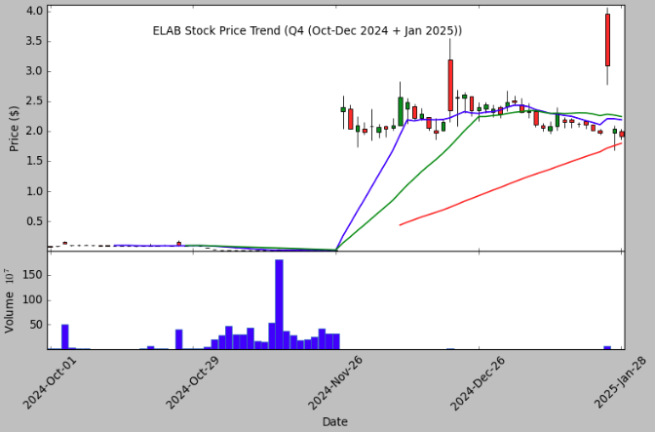
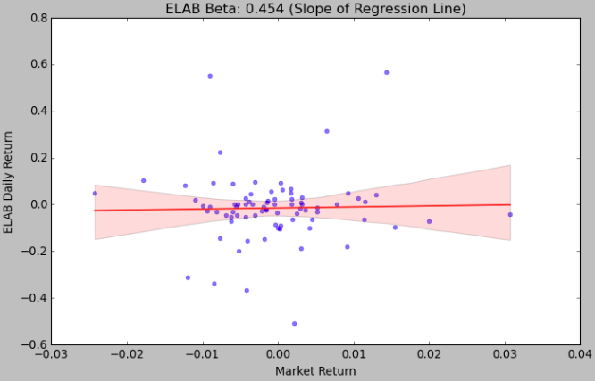
ELAB
Key Insights
✅ Momentum-Driven Growth: Showed steady gains before a sharp breakout in January, signaling potential bullish sentiment.
✅ High Volatility: Experienced frequent price swings, indicating higher risk but also greater profit potential.
✅ Unstable Liquidity: Trading volume spiked during key price movements but remained inconsistent.
✅ Strong Market Correlation (0.454 Beta): Reacted significantly to market trends, making it a high-risk, high-reward option.

Slide 12
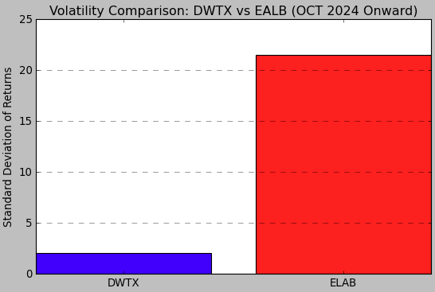
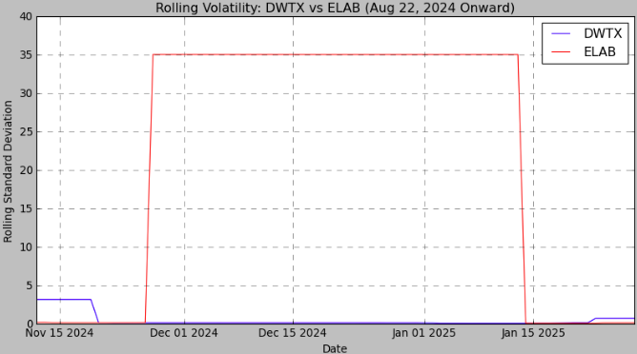
DWTX - ELAB
Key Insights
✅ Greater Stability & Trend Consistency: DWTX maintained steadier price movements with fewer extreme swings, while ELAB experienced sharp fluctuations.
✅ Superior Liquidity Control: DWTX showed consistent trading volume, ensuring smoother execution, whereas ELAB had irregular liquidity spikes.
🏆 Overall Winner: DWTX
✅ Lower Volatility: DWTX exhibited more controlled price deviations, reducing risk compared to ELAB’s erratic movements.
✅ More Reliable Market Behavior: DWTX’s stable trend and liquidity make it a safer and more predictable choice.

Slide 13
THE STOCKBOWL
ROUND 1
HIGHLIGHTS
DWTX stock wins against ELAB!
Next up: NVDA vs DWTX

Slide 14
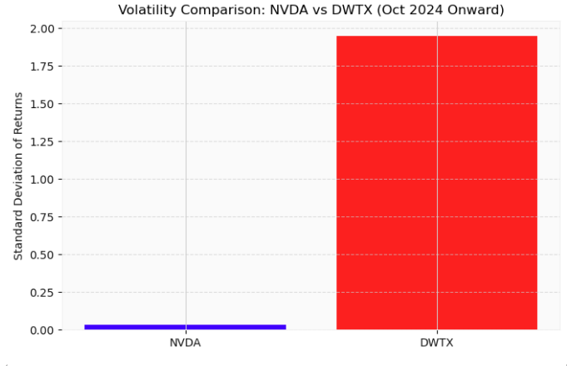
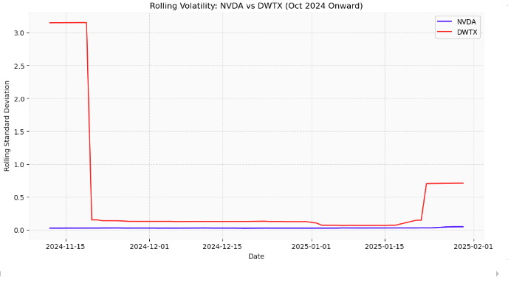
NVDA - DWTX
Key Insights
✅ Stronger Stability – NVDA maintained a steady price trend with fewer drastic swings, while DWTX showed sharp fluctuations and an unstable breakout.
✅ More Predictable Trend – NVDA followed a controlled trajectory, whereas DWTX displayed extreme price swings, making it riskier.
✅ Superior Liquidity – NVDA had higher and more consistent trading volume, ensuring efficient trade execution.
✅ Lower Volatility – DWTX experienced significantly higher volatility, increasing risk, while NVDA remained more stable.
🏆 Overall Winner: NVDA
NVDA outperformed DWTX based on stability, trend consistency, liquidity, and volatility control.

Slide 15
THE STOCKBOWL
ROUND 2
HIGHLIGHTS
NVDA stock wins against ELAB!
Next up: YIBO vs AVGX

Slide 16
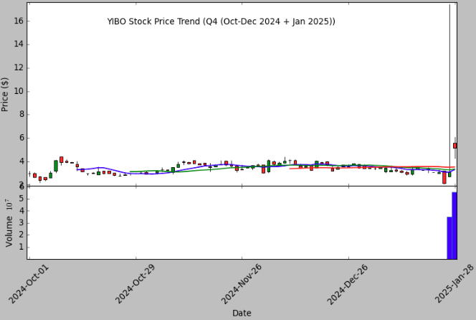
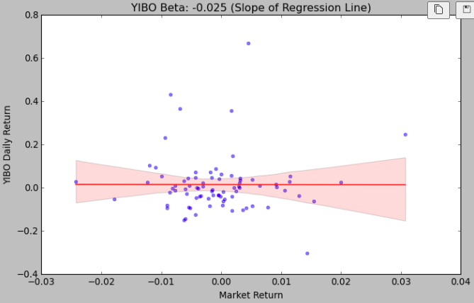
YIBO
Key Insights
✅ Sideways Trend with Late Breakout: Mostly stable before a January breakout, signaling short-term bullish momentum but weaker overall consistency.
✅ Controlled Volatility Until Late: Fluctuations remained moderate before sharp swings in the final phase.
✅ Inconsistent Liquidity: Low volume during stability, surging during the breakout.
✅ Weak Market Correlation (-0.025 Beta): Some independence from market trends but less than other negative beta stocks.

Slide 17
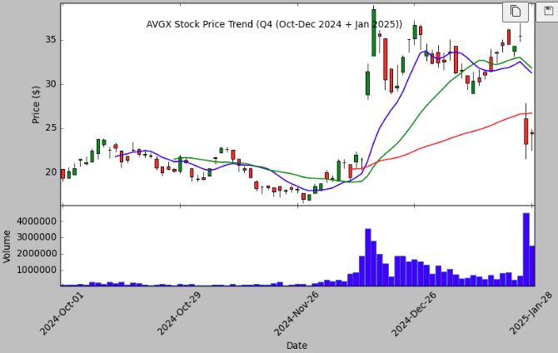
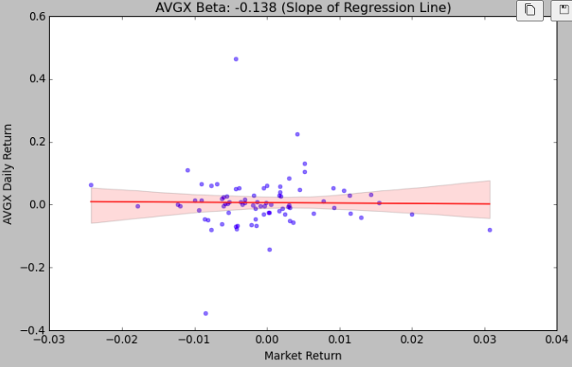
AVGX
Key Insights
✅ Stable but Fluctuating Trend: AVGX followed a steady path with periodic swings before a final breakout, making its trend less predictable.
✅ Moderate Volatility: Frequent price swings made AVGX riskier than YIBO.
✅ Steady Liquidity: Consistently high trading volume supported efficient trade execution.
✅ Moderate Market Correlation (-0.138 Beta): Slightly more reactive to market shifts but remained relatively independent.

Slide 18
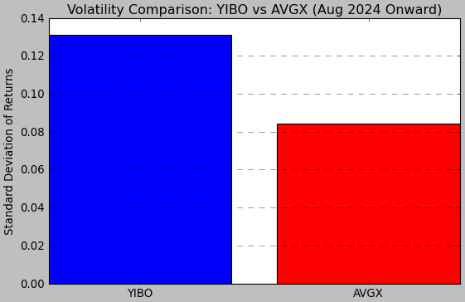
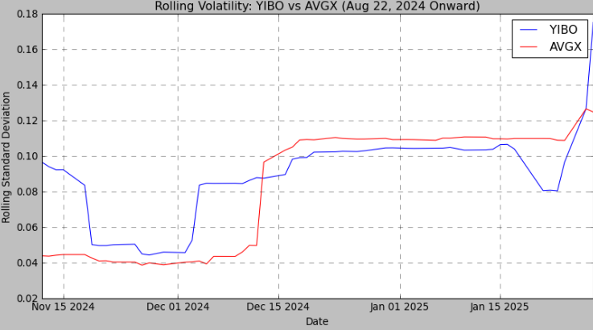
YIBO - AVGX
Key Insights
✅ Stronger Stability & Trend Consistency: AVGX followed a steadier price trajectory, while YIBO had sharp fluctuations, making AVGX more reliable.
✅ Lower Volatility & Better Risk Control: AVGX maintained more controlled price movements, reducing risk compared to YIBO’s higher fluctuations.
🏆 Overall Winner: AVGX
✅ Greater Predictability: AVGX’s steadier trend reduces uncertainty, making it a more stable investment.
✅ Safer Liquidity & Execution: More controlled volatility ensures smoother trade execution and better market efficiency.

Slide 19
THE STOCKBOWL
ROUND 1
HIGHLIGHTS
AVGX stock wins against YIBO!
A loser stock makes it to the next round!
An ETF beat another stock!
Next up: AKRO vs NRO

Slide 20
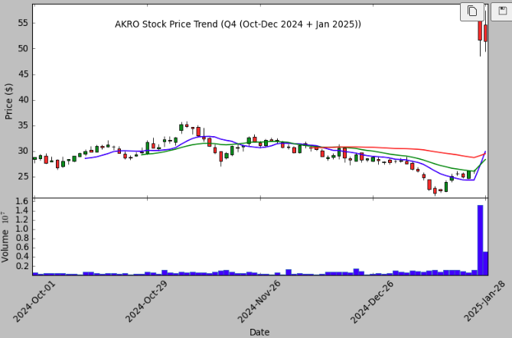
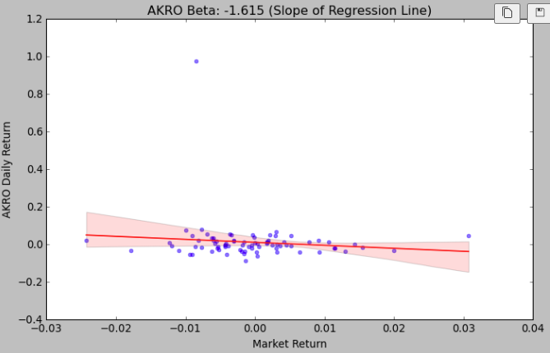
AKRO
Key Insights
✅ Fluctuating but Resilient Trend: AKRO experienced frequent price swings but maintained a relatively stable trajectory before a final breakout, making its trend less predictable.
✅ High Volatility: Large price fluctuations indicate a riskier profile, but they also present greater short-term profit potential.
✅ Strong Liquidity: Consistently high trading volume ensured smooth execution and efficient market participation.
✅ Highly Negative Beta (-1.615): Strong inverse correlation to the market, meaning AKRO moves in the opposite direction of broader trends, making it a hedge against general market downturns.

Slide 21
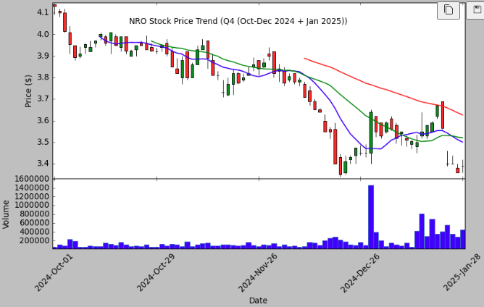
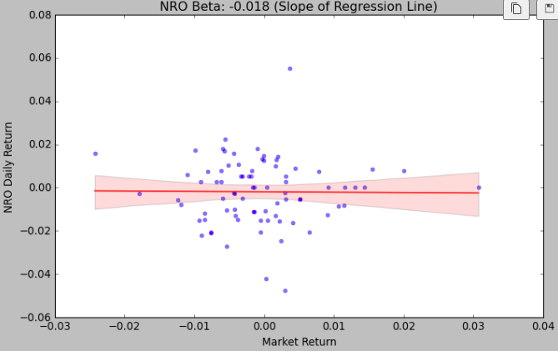
NRO
Key Insights
✅ Stable but Weakening Trend: NRO followed a mostly stable path but showed signs of decline with periodic fluctuations, making its trend less reliable.
✅ Low Volatility: Price movements remained relatively controlled, reducing risk but also limiting potential gains.
✅ Consistent Liquidity: Trading volume stayed steady, ensuring smooth trade execution and market efficiency.
✅ Minimal Market Correlation (-0.018 Beta): Weak correlation with the market, indicating that NRO's price movements are largely independent of broader trends but not as significantly negative as AKRO.

Slide 22
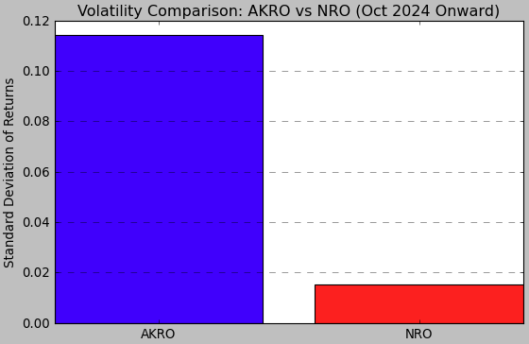
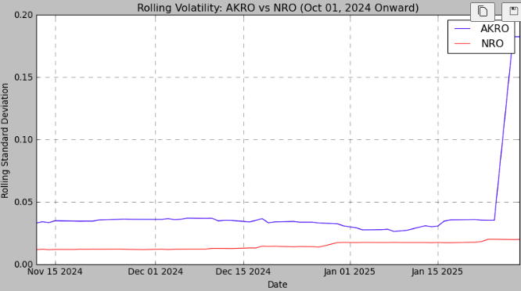
AKRO - NRO
Key Insights
✅ Higher Volatility in AKRO: AKRO had larger price swings, making it riskier but with higher return potential, while NRO maintained steadier movements.
✅ More Stable Trend in NRO: NRO followed a smoother trajectory with fewer fluctuations, making it the more reliable option.
🏆 Overall Winner: NRO
✅ Lower & More Controlled Volatility: NRO’s reduced standard deviation made it the safer, more predictable choice.
✅ Consistent Liquidity: NRO maintained steadier trading volume, ensuring smoother trade execution compared to AKRO’s fluctuations.

Slide 23
THE STOCKBOWL
ROUND 1
HIGHLIGHTS
NRO stock wins against AKRO!
A loser stock makes it to the next round!
Next up: AVGX vs NRO

Slide 24
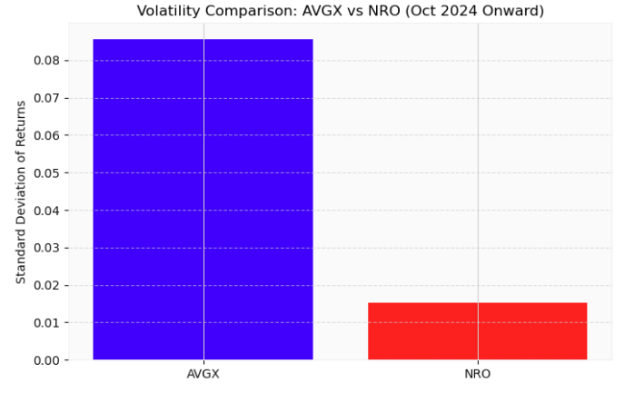
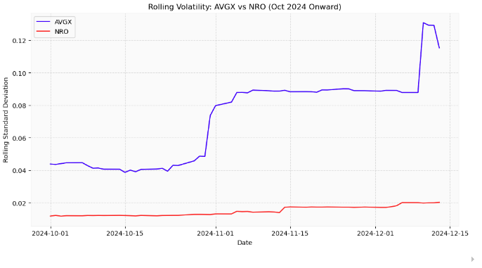
AVGX - NRO
Key Insights
✅ Stronger Stability – AVGX maintained a steady price trend with sustained upward movement, whereas NRO showed a weaker trajectory with consistent declines.
✅ More Predictable Trend – AVGX followed a controlled growth pattern, while NRO experienced inconsistent price movement, making it a less reliable option.
✅ Superior Liquidity – AVGX had higher and more consistent trading volume, ensuring smoother trade execution, while NRO exhibited lower liquidity.
✅ Higher Volatility – AVGX experienced greater price fluctuations and rising volatility, increasing risk, while NRO maintained more controlled price movements.
🏆 Overall Winner: AVGX
AVGX outperformed NRO based on stability, trend consistency, liquidity.

Slide 25
THE STOCKBOWL
ROUND 2
HIGHLIGHTS
AVGX stock wins against NRO!
Next up: NVDA vs AVGX

Slide 26
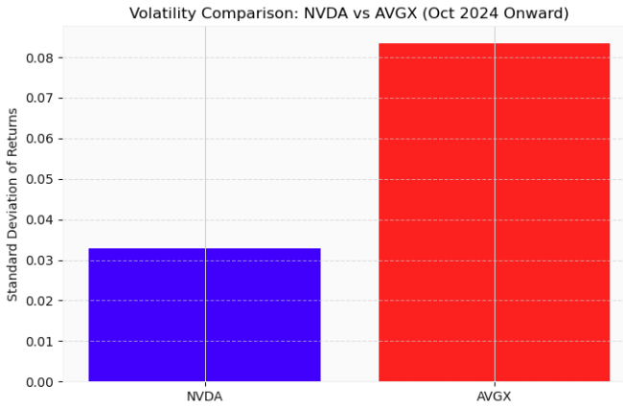
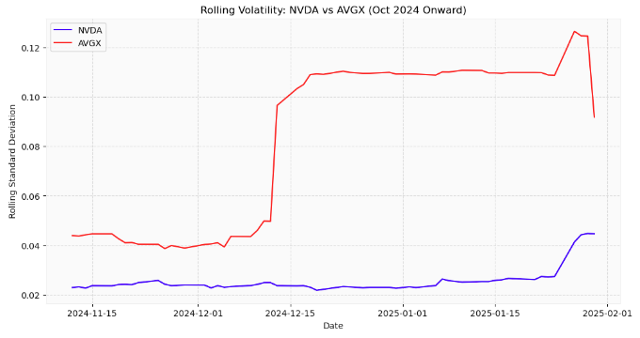
NVDA - AVGX
Key Insights
✅ Stronger Stability – NVDA maintained a more consistent price trajectory with fewer fluctuations, while AVGX displayed sharper movements, increasing short-term uncertainty.
✅ More Predictable Trend – NVDA followed a steadier pattern, whereas AVGX showed higher variance, making it a riskier option for long-term stability.
✅ Superior Liquidity – NVDA had higher trading volume and better liquidity, ensuring smoother trade execution, while AVGX exhibited periods of lower liquidity.
✅ Volatility – AVGX had significantly higher volatility, as seen in both rolling and static standard deviations, increasing overall investment risk compared to NVDA.
🏆 Overall Winner: NVDA
NVDA outperformed AVGX based on stability, trend consistency, liquidity, and volatility control.

Slide 27
THE STOCKBOWL
ROUND 3
HIGHLIGHTS
NVDA stock wins against AVGX!
The ETF was not able to beat the Top S&P 500 Stock.
Overall Stockbowl Winner: NVDA

Slide 28

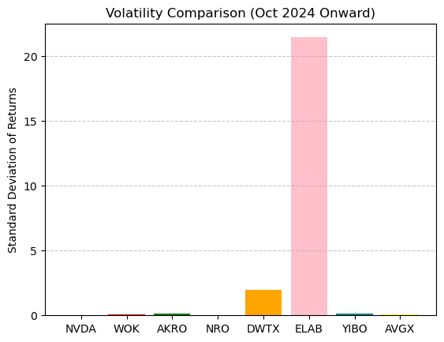
BUILDING A
PORTFOLIO
Diversification
Invest in stocks with low-risk and stable prices.
Invest in stocks with high-risk and volatile prices.
Top 4 Stocks that potentially bring diversity:
DWTX
ELAB
NVDA
AVGX
For our Stockbowl, some stocks were eliminated earlier
on in the first round.
The purpose of this analysis is to compare all 8 against each other to see which one would be in the top 4.
The top 4 stocks in this comparison also includes ELAB which was one of the stocks that didn’t make it past the first round.

